Slide 1

Analysis of Medical Costs and Influencing Factors
“Key Insights into Demographics, Lifestyle Risks, and Regional Drivers of Insurance Costs”
We uncover actionable insights for healthcare professionals, insurers, and policymakers.
Presented by: Ritu

Slide 2
Overview of Medical Analysis Project
The dataset explores how demographic and lifestyle factors like age, gender, BMI, smoking, dependents, and region influence medical charges.
Average, median, and standard deviation reveal large variation in costs, showing that healthcare expenses differ widely among individuals.
Gender comparison shows one gender (usually males) tends to have slightly higher BMI and medical costs.
Smokers consistently have much higher average medical charges than non-smokers, confirming strong health-cost impacts of smoking.
Correlation between number of children and charges is weak, suggesting dependents don’t strongly affect personal medical costs.
Regional analysis indicates one U.S. region—often the Southeast—records the highest average medical charges and BMI levels.
Histogram results show most medical charges fall into a middle cost bracket, while a few very high charges skew the distribution.
BMI classification shows most beneficiaries fall in the Normal and Overweight ranges, with fewer being Underweight or Obese.
Scatter plot and correlation analysis reveal a weak positive relationship between BMI and charges—higher BMI slightly increases costs.
The interactive dashboard visually summarizes all key insights, helping stakeholders filter by gender, smoking status, region, and BMI for quick decision-making.

Slide 3

Basic Statistics and Data Understanding
Age distribution appears balanced, as the average and median values are closely aligned.
BMI also shows a stable pattern with minimal skewness, reflecting a consistent distribution.
Medical charges display a noticeable gap between average and median, indicating the presence of high-cost outliers.
The spread of medical charges is significantly wider than that of age or BMI, showing high variability in healthcare costs.
Overall, age and BMI remain steady across the population, while medical charges fluctuate greatly due to external influencing factors.

Slide 4

Gender Analysis
Both genders show very similar average BMI values, indicating consistent body mass patterns across the population.
Average medical charges differ noticeably between genders, with one group tending to incur higher healthcare costs.
The chart highlights that BMI does not significantly vary by gender, suggesting limited influence of gender on body weight trends.
However, medical charges display a clearer gap, implying gender-related differences in healthcare utilization or medical conditions.
The horizontal bar chart effectively contrasts these differences, making the cost variation more visually prominent than BMI variation.
Overall, BMI remains stable across genders, while healthcare expenses show a more distinct divergence.

Slide 5
Impact of Smoking on Costs
The chart highlights a strong contrast in average charges between smokers and non-smokers.
Smokers show significantly higher medical expenses compared to non-smokers.
This gap suggests that smoking has a substantial financial impact on healthcare costs.
The visual clearly demonstrates how lifestyle choices can drive large differences in medical spending.
Non-smokers maintain much lower average charges, reflecting fewer high-cost medical interventions.
Overall, the chart emphasizes smoking as a major factor contributing to elevated healthcare expenses.

Slide 6
Dependents Analysis
Individuals with 0 dependents show medical charges ranging up to around 60,000+, indicating high variation even without dependents.
For 1 dependent, charges still spread widely, with several cases reaching around 50,000–60,000, similar to those with no dependents.
People with 2 dependents display charges that commonly fall between 5,000 and 45,000, showing moderate variation.
Those with 3 dependents also reach amounts above 60,000, proving that high charges occur across multiple dependent categories.
Individuals with 4 dependents generally show lower maximum values, clustering below 40,000.
At 5 dependents, charges mostly remain under 20,000, suggesting fewer high-cost cases in this group.

Slide 7
Geographical Insights
The Southeast region shows the highest average BMI among all regions in the comparison.
The Southwest, Northwest, and Northeast regions have similar BMI levels, with only slight differences.
Medical charges vary more noticeably across regions than BMI does, indicating regional cost differences.
The Southeast region also records the highest medical charges, suggesting greater healthcare expenditure there.
Other regions have moderate and fairly close medical charge levels, showing more consistency in their costs.
Overall, the chart reveals stronger geographical variation in charges than in BMI values.

Slide 8
Cost Distribution Analysis
The data distribution is heavily skewed to the right, showing a long tail towards higher values.
The vast majority of the data is concentrated in the initial bins, indicating a high frequency of lower values.
Frequency drops off sharply after the first few bins, confirming the strong positive skew.
The modal class (highest frequency) occurs in the very first bin shown on the chart.
A small number of occurrences are observed across the wider range of medium to higher values.
Occurrences in the highest value ranges (the 'MORE' bin and its preceding bins) are negligible.

Slide 9
BMI Classification
The largest segment of the population falls into the Obese category, representing more than half of the total.
Overweight individuals make up the second-largest group, contributing a significant portion.
The combined percentage of individuals classified as Overweight and Obese represents an overwhelming majority of the total population.
Individuals with a Normal BMI constitute a minor group, being less than one-fifth of the total.
The proportion of people classified as Underweight is extremely small, making it the least represented group.
The chart clearly illustrates a significant public health issue with the prevalence of higher BMI classifications.
Fewer than half of the individuals represented are at a normal or underweight BMI.
The distribution is heavily skewed towards the higher BMI categories (Overweight and Obese).

Slide 10
Advanced Correlation Analysis
Advanced Correlation Analysis between BMI and medical charges. The correlation coefficient (0.19834097 ) indicates a weak positive relationship, meaning higher BMI slightly increases medical costs but not strongly. The scatter plot with a trendline visualizes this mild upward trend.
As BMI increases, medical costs rise slightly — about ₹394 per BMI point —
but since R² is only 0.0393, BMI alone doesn’t explain much; other factors matter more.
Consequences: This suggests that while obesity contributes to higher healthcare expenses, it’s not the sole factor. Other variables like age, smoking, and chronic conditions may play a more significant role in driving medical costs.

Slide 11
Smoking and Region Interaction
Smoking Status is the dominant factor influencing medical charges, creating a massive cost difference compared to non-smokers across all regions.
The average charges for smokers are significantly higher than those for non-smokers in every geographic region.
The overall population profile shows a major public health concern, with the majority of individuals categorized as Overweight or Obese.
The proportion of people falling into the Normal BMI range is relatively small, with Underweight being the least represented group.
There is a very weak positive correlation between an individual's Body Mass Index (BMI) and their corresponding medical charges.
The correlation analysis suggests that BMI is a poor predictor of charges, implying other factors, like smoking status, have a far greater impact on costs.

Slide 12
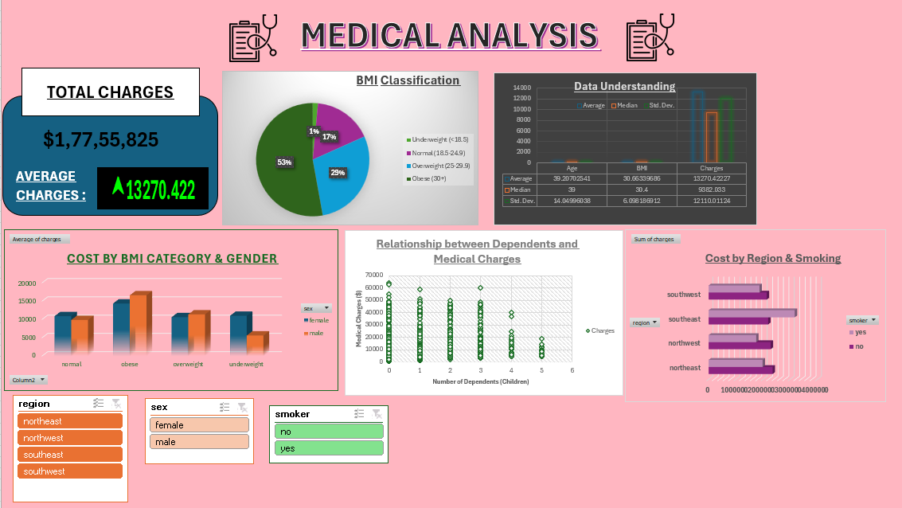
D
A
S
H
B
O
A
R
D

Slide 13

Overall Dashboard Analysis
The dataset shows a high total medical expenditure, with the average charge reflecting substantial overall healthcare costs.
Age, BMI, and charges indicate noticeable variability, especially in medical costs compared to demographic attributes.
BMI classification reveals that the majority of individuals fall into the overweight and obese categories.
Medical charges rise significantly for obese individuals, particularly among males.
Smokers consistently incur far higher charges than non-smokers across all regions.
Geographical analysis shows that the Southeast region experiences the highest average medical expenses.
The number of dependents shows no strong correlation with medical charges, with costs fluctuating across all family sizes.
Overall, lifestyle factors—such as obesity and smoking—play a stronger role in driving medical costs than demographics or geography alone.

Slide 14

https://youtu.be/LkxaS82KktQ [Paste this link into your browser to watch the full YouTube presentation.]

